Slide 1
Weather Dashboard with API Integration
姓名：彭勇智
学号：1820202027

Slide 2
1.0 Project Objective
To delve into the practical application of Qt software, to create an intuitive and functional graphical user interface (GUI) for a weather dashboard integrated with APIs.
To deepen knowledge of Qt but also strengthen practical skills in GUI design and implementation.
To develop a fully operational interface, capable of displaying real-time weather data
Notes:
1. To delve into the practical application of Qt software, with a specific focus on leveraging Qt Designer to create an intuitive and functional graphical user interface (GUI) for a weather dashboard integrated with APIs. 2. This endeavour will not only deepen knowledge of Qt but also strengthen practical skills in GUI design and implementation. 3. Upon project completion, a fully operational interface will be developed, capable of displaying real-time weather data such as temperature, humidity, and forecasts.

Slide 3
2.0 Specification
It serves as a practical tool for staying informed about current weather conditions, aiding in planning for work and outdoor activities
By utilizing APIs like OpenWeatherMap, the dashboard can retrieve real-time data
Enhance this system with an alert feature that provides warnings for severe weather
allow users to prepare for adverse conditions by taking precautions
It could be adapted for additional purposes, integrating APIs for air quality or fire weather information, offering broader utility and improving everyday convenience

Slide 4
3.0 Development Setup
Qt Designer
Qt Creator
C++
OpenWeatherMap API
OpenSSL
Notes:
Qt Designer: This tool serves as the primary platform for crafting the visual components of the user interface, including buttons, text fields, and labels, through an intuitive drag-and-drop mechanism.
Qt Creator will be employed to develop the C++ backend, enabling the integration of the UI with real-time weather data retrieval using an API key.
The backend logic will be implemented in C++.
OpenWeather offers a free API for accessing real-time weather data for any specified location. This API aggregates and processes data from various sources, including global and regional weather models, satellites, radars, and an extensive network of weather stations.
To leverage the Qt Network module and enable TLS functionality, it is crucial to install a compatible version of OpenSSL. For instance, the OpenSSL 1.1.1g Win64 package is compatible with Qt version 5.15.2.

Slide 5
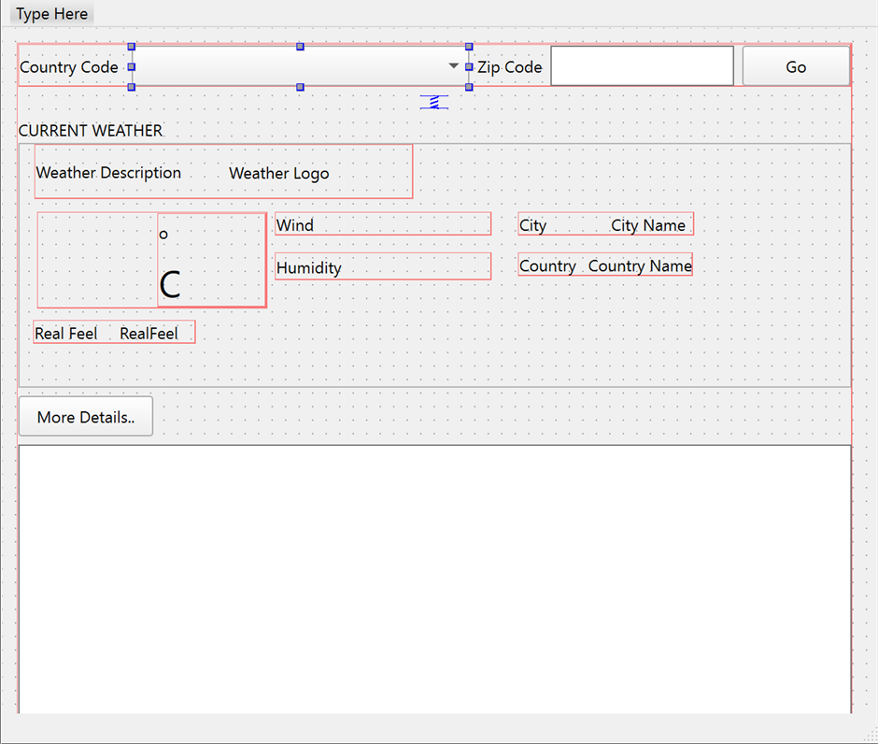
4.0 UI design

Slide 6
5.0 Implementation Details
Weather Data Handling
create the API URL with the inputs of zip code, country code, and API key
send the requests by using the Qt Network module.
Receiving and Displaying Weather Data
read the data and parse the JSON response.
extract the data from the JSON response such as weather description, humidity and temperature. This information will then display in the UI interface successfully.
Notes:
Weather Data Handling: In getWeatherData section, we create the API URL with the inputs of zip code, country code, and API key. We send the requests by using the Qt Network module. Then, we connect the reply finished signal to a slot to process the result.
Error Handling: If there is an error from the reply, this suggests that network error and sends the message “No Data Found!”.
Receiving and Displaying Weather Data: In onWeatherDataReceived section, after obtaining the reply, we read the data and parse the JSON response. Next, we extract the data from the JSON response such as weather description, humidity and temperature. This information will then display in the UI interface successfully.

Slide 7
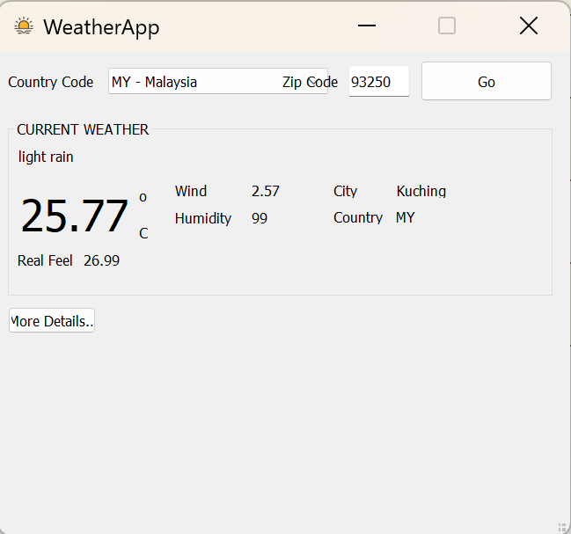
6.0 Testing and Results

Slide 8
THANK YOU FOR YOUR LISTENING

